Slide 1
Infectious Diseases
Fungi and Fungal Diseases
Fungi
  structure
Chytridiomycosis
  Pathogenic fungi name, structure & ecology
  Life cycle of the pathogenic fungi
  Impact on host
  Control

Slide 2
Infectious Disease
Syllabus:
The major groups of organisms that cause disease are bacteria, fungi, protists and viruses; each group can be distinguished by its structural characteristics
The life cycle of a pathogen and its associated diseases, including the method of invading the host, the impact on the host, and the mode of transmission (direct or indirect), determines its success for survival
Describe the structure of fungi
Describe the life cycle of a the pathogenic fungi that causes Chytridiomycosis
Describe the modes of transmission of Chytridiomycosis
Biozone
80 – Fungal Diseases
Biology WA UNITS 3 & 4
Reading
Chapter 12 – pages 418 – 420
Chapter 13 – pages 445 – 446
Essential
Question:
Topic Question 1:
Briefly describe a fungi

Slide 3
Topic Question 2:
List the structural characteristics of fungi
Viruses | Bacteria | Fungi
Topic Question 3:
Compare the structural characteristics of viruses, bacteria and fungi

Slide 4
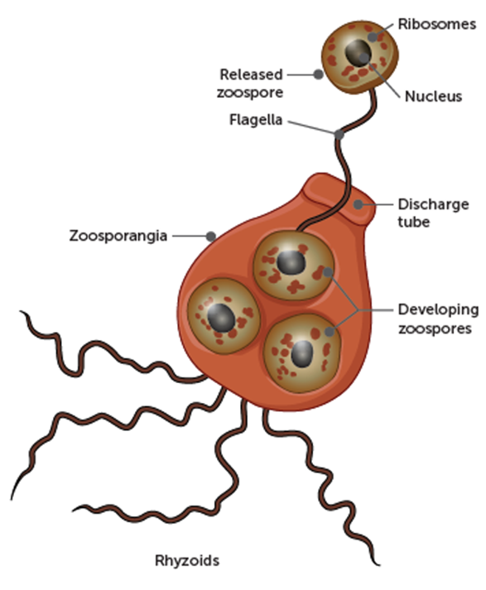
Topic Question 4:
State the name of the pathogenic fungi that causes Chytridiomycosis and the organisms that are affected by the disease
Topic Question 5:
List the structural features of the Chytridiomycosis fungi
Term | Definition
Zoospore
Zoosporangia
Thallus

Slide 5
Topic Question 6:
Using the article on Chrytridiomycosis describe the ecology of the Chytrid fungus

Slide 6
Topic Question 7: Describe the life cycle of the pathogenic fungi that causes Chytridiomycosis
This ________ pathogen has spread around the world, often due to ________ activities, & cause the disease __________________.
An example of a human activity that has lead to the spread of B.dendrobatidis include:
B.dendrobatidis can infect >300 known species of amphibian, includes
It has contributed to ~100 ___________
Life cycle duration is 4 – 5 days at 22˚C

Slide 7
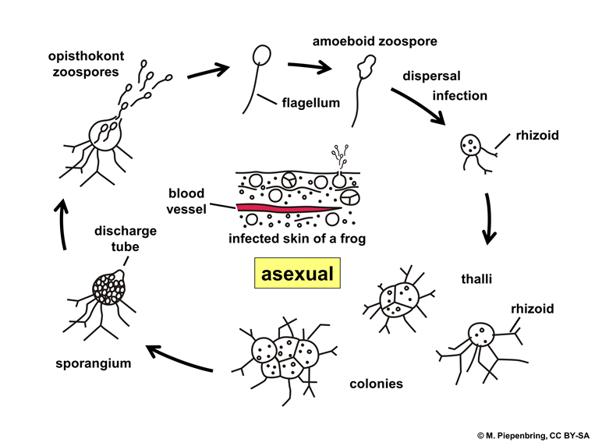
Topic Question 8:
How does the fungi that causes Chytridiomycosis reproduce
Topic Question 9:
State the incubation period of Chytrid
Read page 418 – 420 Biology WA ATAR Units 3 & 4

Slide 8
Topic Question 10:
State the mode of transmission of the pathogenic fungi causing Chytridiomycmosis
Topic Question 11:
List the Impact of the disease on the host

Slide 9
Topic Question 12:
Describe how Chytridiomycosis can be controlled (these are the management strategies that help to stop the spread of the disease)
Use the article on Chytridiomycosis

Slide 10
Topic Question 13:
Use the articles on Chytridiomycosis to explain how a changing climate may affect the spread of the disease Chytridiomycosis

Slide 11

Summary of Chytrid

